Slide 1
Lecture #3: k-NN and Linear Regression

Slide 2
ACADEMY HONESTY
Ethical behavior is an important trait of a Data Scientist, from ethically handling data to attribution of code and work of others. Thus, in CS109 we give a strong emphasis to Academic Honesty .
As a student your best guidelines are to be reasonable and fair. We encourage teamwork problem sets, but you should not split the homework and you should work on all the problems together.
Engaging in not acceptable behavior regarding academic honesty will be handled appropriately.

Slide 3
ACADEMY HONESTY
Engaging in not acceptable behavior regarding academic honesty will be handled harshly.
Please be responsible and when in doubt ask the CS109 Teaching Staff (Kevin and Chris, presumably).

Slide 4
ACADEMY HONESTY
ACCEPTABLE:
➔ Discussing materials and engaging in OH.
➔ Helping debug.
➔ Using a few lines of code found online or other forum as long as you cite the origin and attribute authorship of code.
➔ Searching online to expand your knowledge and for debugging, but not for outright solutions to HW.
➔ Using a tutor, provided the tutor does not do your work for you.

Slide 5
ACADEMY HONESTY
NOT ACCEPTABLE:
➔ Accessing a solution to some problem prior to submitting your own.
➔ Failing to cite the origins of code or techniques that you discover outside of the course’s own lessons and integrate into your own work.
➔ Searching for or soliciting outright solutions to problem sets online or elsewhere. Or providing solutions to problem sets to individuals who might take this course in the future.
➔ Paying or offering to pay an individual for work that you may submit as your own.
➔ Splitting a problem set’s workload with another individual and combining your work.

Slide 6
Background
Roadmap:
Lecture 1
Lecture 2 and Lab1
This lecture
(and next 2 lectures)
What is Data Science?
Data: types, formats, issues, etc, and briefly visualization
How to quickly prepare data and scrape the web
How to model data and evaluate model fitness.
Linear regression, confidence intervals, model selection cross validation, regularization

Slide 7
Lecture Outline
Statistical Modeling
k-Nearest Neighbors (kNN)
Simple Linear Regression
Model Fitness
How does the model perform at predicting?
Comparison of Two Models
How do we choose from two different models?
Probabilistic Basis of Regression
Hypothesis Testing and Confidence Intervals
Bootstrap Resampling

Slide 8
Predicting a Variable
Let's image a scenario where we'd like to predict one variable using another (or a set of other) variables. Or would like to determine the association of one variable with another (or set of other) variables.
Examples:
Predicting the amount of view a YouTube video will get next week based on video length, the date it was posted, previous number of views, etc.
Predicting which movies a Netflix user will rate highly based on their previous movie ratings, demographic data etc.
Determining what background factors are associated with how much time a student spends on HW1.

Slide 9
Data
The Advertising data set consists of the sales of that product in 200 different markets, along with advertising budgets for the product in each of those markets for three different media: TV, radio, and newspaper. Everything is given in units of $1000.
,
TV | radio | newspaper | sales
230.1 | 37.8 | 69.2 | 22.1
44.5 | 39.3 | 45.1 | 10.4
17.2 | 45.9 | 69.3 | 9.3
151.5 | 41.3 | 58.5 | 18.5
180.8 | 10.8 | 58.4 | 12.9
Some of the figures in this presentation are taken from "An Introduction to Statistical Learning, with applications in R" (Springer, 2013) with permission from the authors: G. James, D. Witten, T. Hastie and R. Tibshirani "
Notes:
Supposed we were asked by a client to provide advice on how to improve sales of a particular product.
Does that footnote belong on this slide?

Slide 10
Response vs. Predictor Variables
There is an asymmetry in many of these problems:
The variable we'd like to predict may be more difficult to measure, is more important than the other(s), or may be directly or indirectly influenced by the values of the other variable(s).
Thus, we'd like to define two categories of variables:
variables whose value we want to predict (response, Y)
variables whose values we use to make our prediction (predictors, X_{i})
Notes:
Give an example

Slide 11
Response vs. Predictor Variables
X
predictors
features
covariates
Y
outcome
response variable
dependent variable
TV | radio | newspaper | sales
230.1 | 37.8 | 69.2 | 22.1
44.5 | 39.3 | 45.1 | 10.4
17.2 | 45.9 | 69.3 | 9.3
151.5 | 41.3 | 58.5 | 18.5
180.8 | 10.8 | 58.4 | 12.9
n observations
p predictors

Slide 12
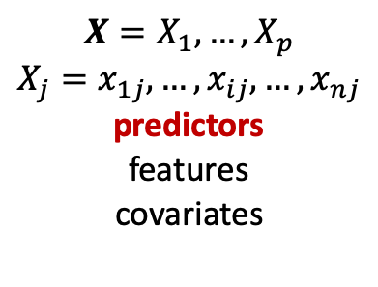
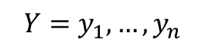
Response vs. Predictor Variables
$$X=X_{1},…,X_{p}$$
$$X_{j}=x_{1j},…,x_{ij},…,x_{nj}$$
predictors
features
covariates
outcome
response variable
dependent variable
$$Y=y_{1},…,y_{n}$$
TV | radio | newspaper | sales
230.1 | 37.8 | 69.2 | 22.1
44.5 | 39.3 | 45.1 | 10.4
17.2 | 45.9 | 69.3 | 9.3
151.5 | 41.3 | 58.5 | 18.5
180.8 | 10.8 | 58.4 | 12.9
n observations
p predictors
Notes:
I changed y_p to y_n. I think this makes the dimensions correct now. (DLS)

Slide 13
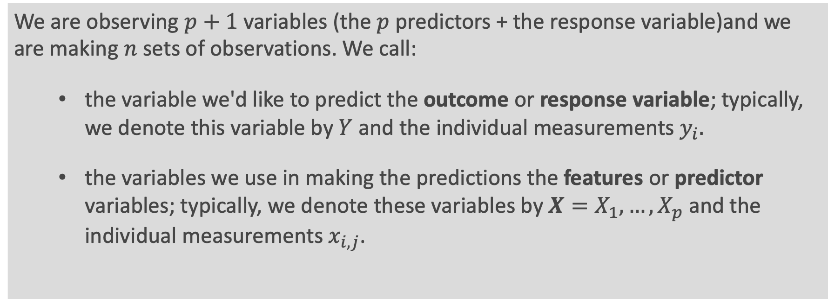
Definition
We are observing $p+1$variables (the $p$ predictors + the response variable)and we are making $n$sets of observations. We call:
the variable we'd like to predict the outcome or response variable; typically, we denote this variable by $Y$and the individual measurements $y_{i}.$
the variables we use in making the predictions the features or predictor variables; typically, we denote these variables by $X=X_{1},…,X_{p}$ and the individual measurements $x_{i,j}$.
Note: $i$indexes the observations ($i=1,…,n)$and $j$ indexes the value of the $j$^{th} predictor variable ($j=1,…,p)$.

Slide 14
Statistical Modeling

Slide 15
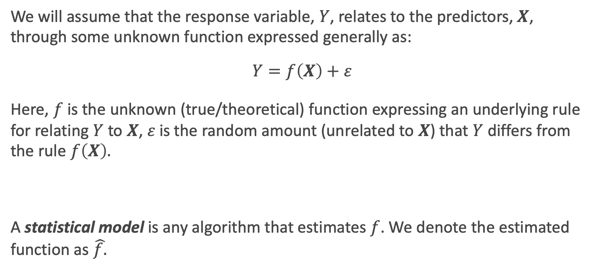
True vs. Statistical Model
We will assume that the response variable, $Y$, relates to the predictors, $X$, through some unknown function expressed generally as:
$$Y=f\left(X\right)+ε$$
Here, $f$ is the unknown (true/theoretical) function expressing an underlying rule for relating $Y$ to $X$, $ε$is the random amount (unrelated to $X$) that $Y$ differs from the rule $f\left(X\right).$
A statistical model is any algorithm that estimates $f$. We denote the estimated function as $\hat{f.}$
Notes:
Change x and y to uppercase? (DLS)

Slide 16
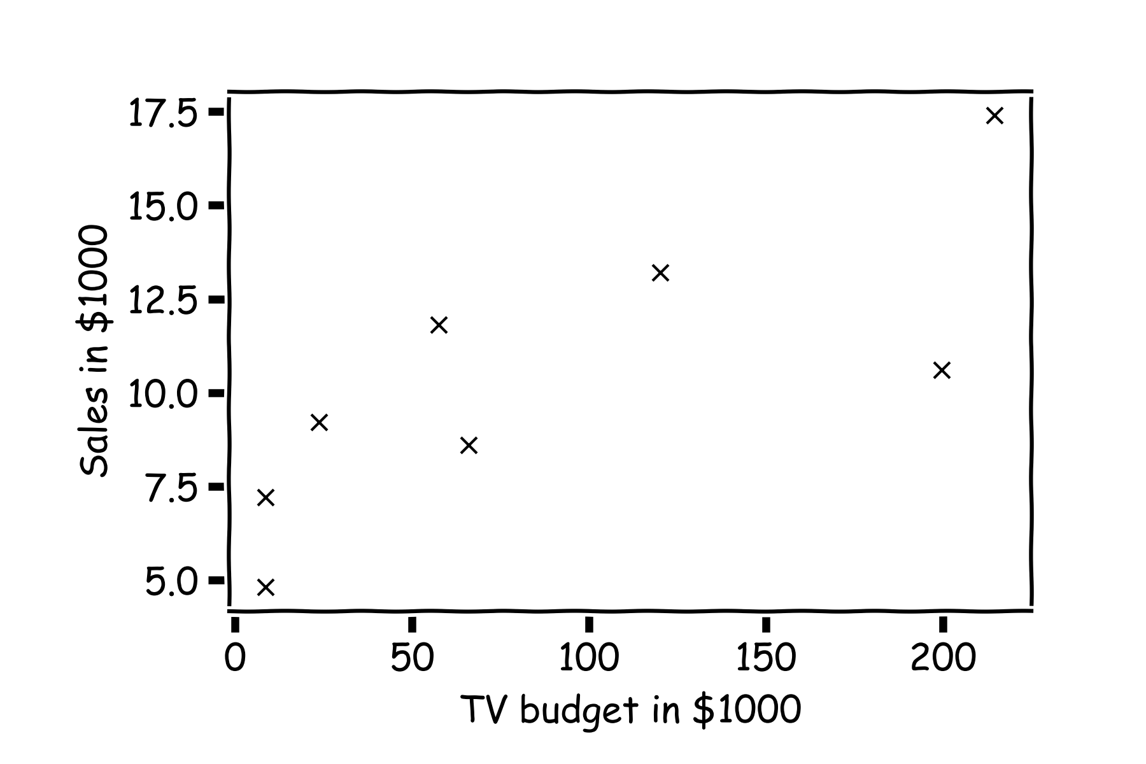
Statistical Model
y
x

Slide 17
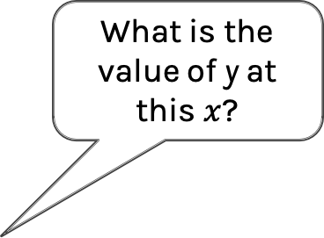
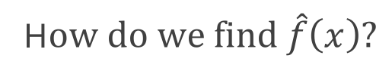
Statistical Model
H$ow do we find \hat{f}\left(x\right)?$
What is the value of y at this $x$?

Slide 18
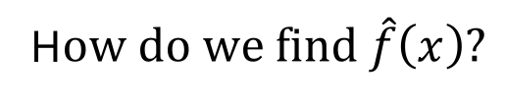
Statistical Model
H$ow do we find \hat{f}\left(x\right)?$
or this one?

Slide 19
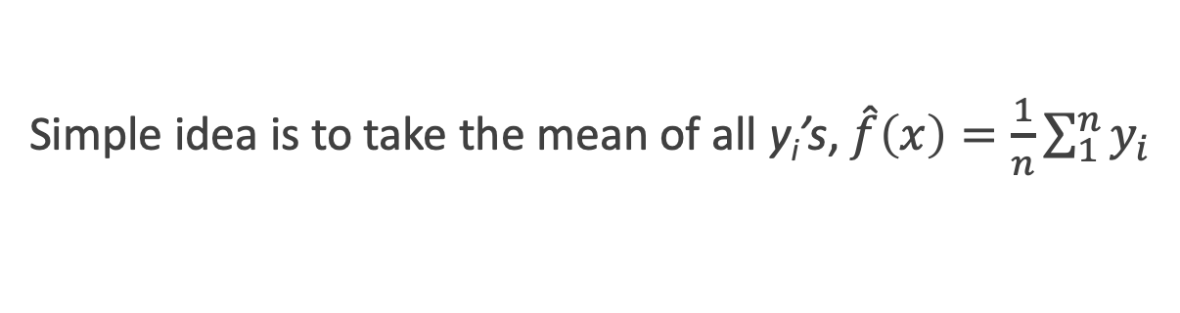
Statistical Model
Simple idea is to take the mean of all y_{i}’s, $\hat{f}\left(x\right)=\frac{1}{n}\sum_{1}^{n}{y_{i}}$

Slide 20
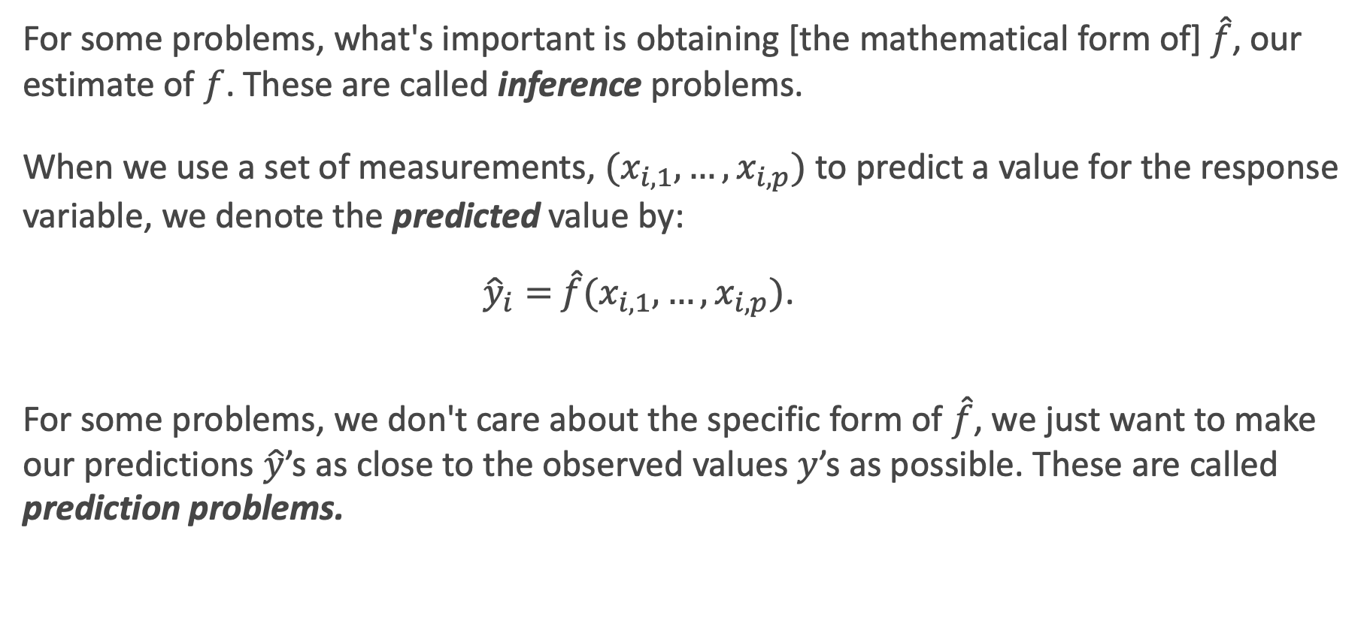
Prediction vs. Estimation
For some problems, what's important is obtaining [the mathematical form of] $\hat{f}$, our estimate of $f$. These are called inference problems.
When we use a set of measurements, $(x_{i,1}, …,x_{i,p})$ to predict a value for the response variable, we denote the predicted value by:
${\hat{y}}_{i}=$ $\hat{f}(x_{i,1}, …,x_{i,p})$.
For some problems, we don't care about the specific form of $\hat{f}$, we just want to make our predictions $\hat{y}$’s as close to the observed values $y$’s as possible. These are called prediction problems.

Slide 21
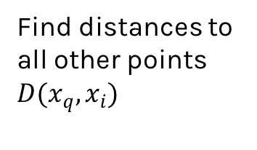
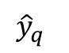
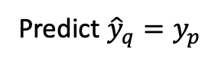
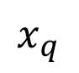
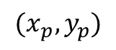
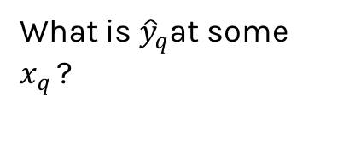
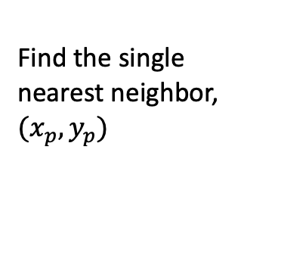
Simple Prediction Model: use most similar observed observations
What is ${\hat{y}}_{q}$at some $x_{q }$?
Find distances to all other points $D(x_{q},x_{i})$
$${(x}_{p},y_{p})$$
$${\hat{y}}_{q}$$
Find the single nearest neighbor, ${(x}_{p},y_{p})$
$$x_{q}$$
Predict ${\hat{y}}_{q}=y_{p}$
Notes:
Is it clear that x_q is really x_i,q? (DLS)

Slide 22
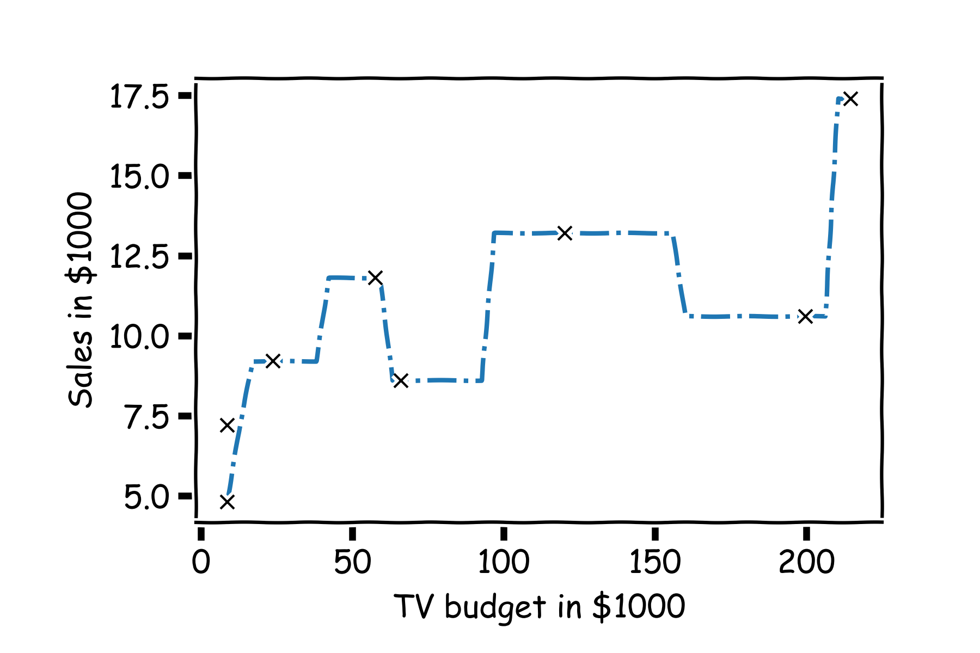
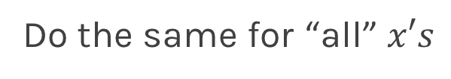
Simple Prediction Model
Do the same for “all” $x′s$

Slide 23
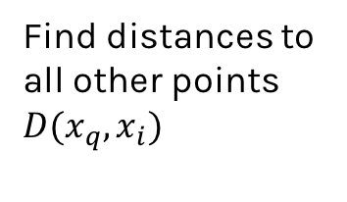
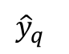
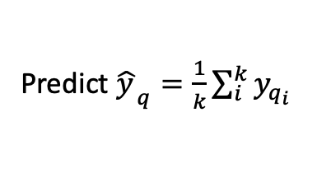
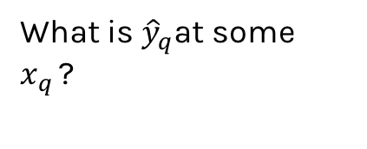
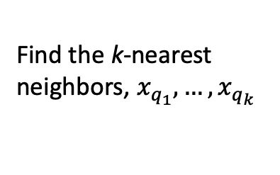
Extend the Prediction Model
What is ${\hat{y}}_{q}$at some $x_{q }$?
Find distances to all other points $D(x_{q},x_{i})$
$${\hat{y}}_{q}$$
Find the k-nearest neighbors, $x_{q_{1}},…,x_{q_{k}}$
Predict ${\hat{y_{ }}}_{q}=\frac{1}{k}\sum_{i}^{k}{y_{q_{i}}}$
$$x_{q}$$
Notes:
Change indeces and show k-nearest

Slide 24
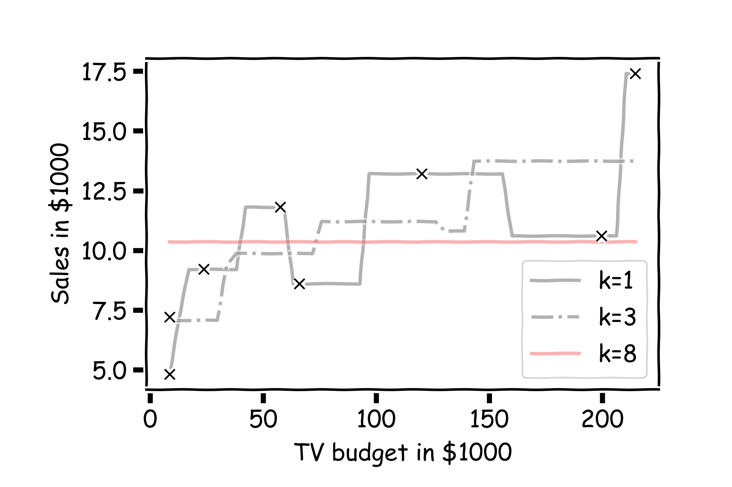
Simple Prediction Models
Notes:
Change indeces and show k-nearest

Slide 25

Simple Prediction Models
We can try different k-models on more data
*Note: the k-NN model for each of the 3 different values of k here can be thought of as
3 different models all within the class of ‘k-NN models’.
Notes:
Change indeces and show k-nearest

Slide 26
k-Nearest Neighbors
The k-Nearest Neighbor (k-NN) model is an intuitive way to predict a quantitative response variable:
to predict a response for a set of observed predictor values, we use the responses of other observations most similar to it
Note: this strategy can also be applied in classification to predict a categorical variable. We will encounter k-NN again later in the course in the context of classification.
Notes:
Change indeces and show k-nearest

Slide 27
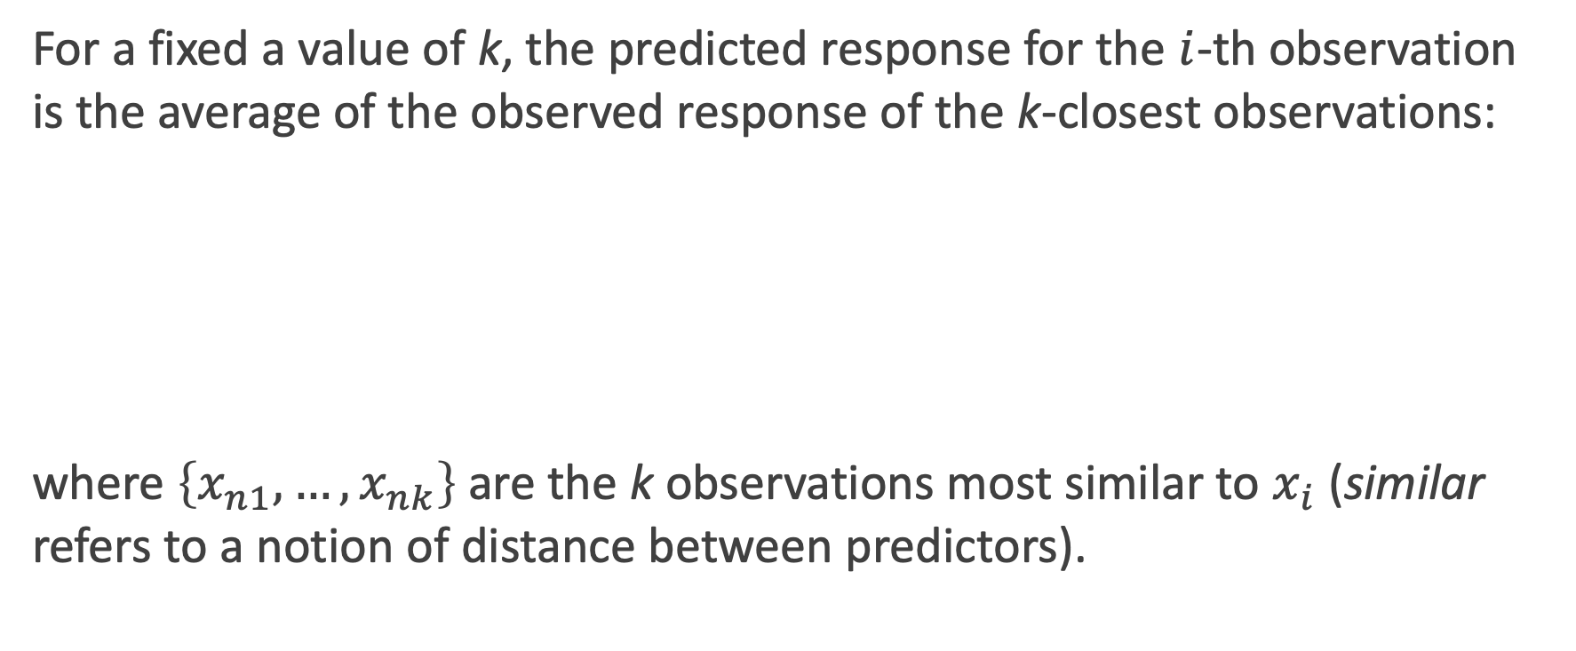
k-Nearest Neighbors – k-NN
For a fixed a value of k, the predicted response for the $i$-th observation is the average of the observed response of the k-closest observations:
where $\left\{x_{n1},…,x_{nk}\right\}$ are the k observations most similar to $x_{i}$ (similar refers to a notion of distance between predictors).
Notes:
Notice y_hat instead of f_hat
I think the index on y_hat is wrong but I can’t change it b/c it’s an image. (DLS)

Slide 28
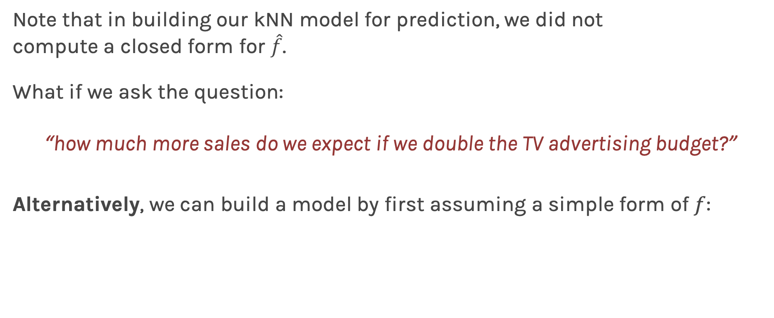
Linear Models
Note that in building our kNN model for prediction, we did not compute a closed form for $\hat{f}$.
What if we ask the question:
“how much more sales do we expect if we double the TV advertising budget?”
Alternatively, we can build a model by first assuming a simple form of $f$:

Slide 29
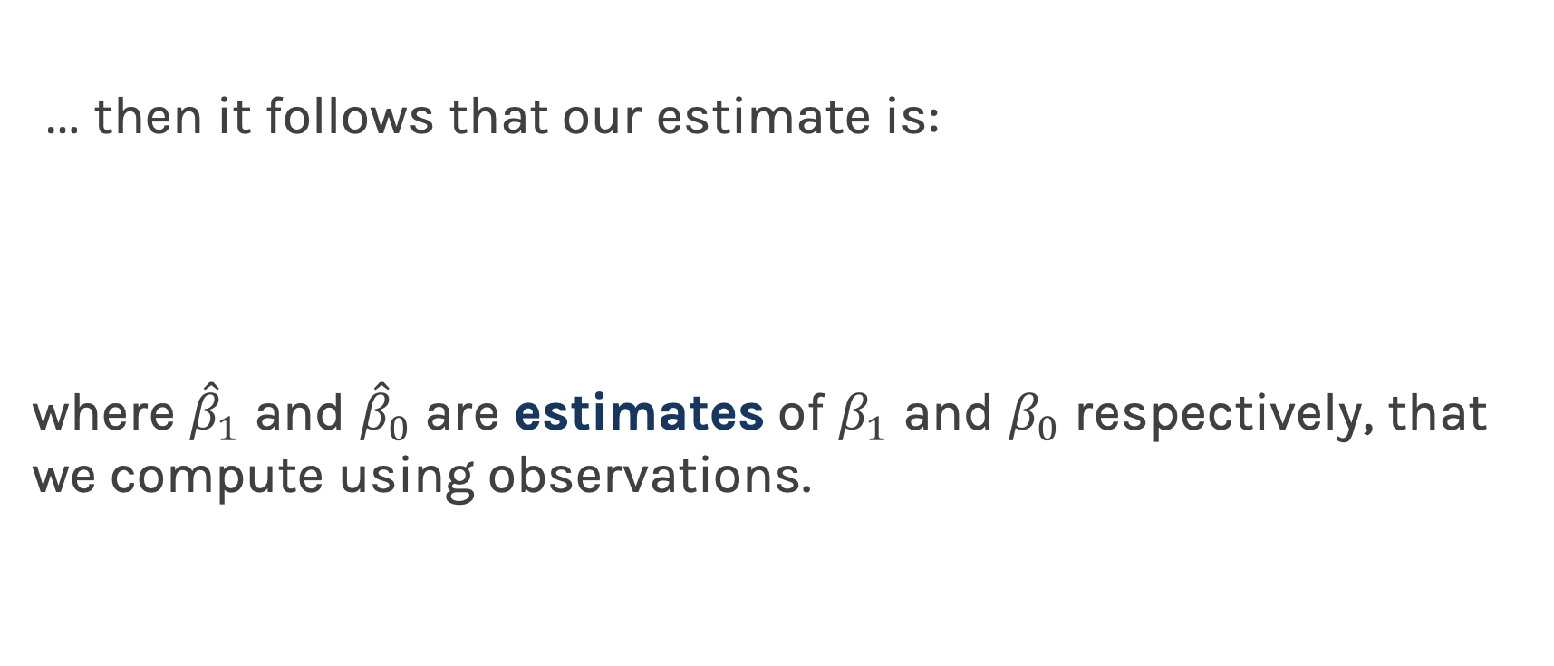
Linear Regression
… then it follows that our estimate is:
where ${\hat{β}}_{1}$ and ${\hat{β}}_{0}$are estimates of $β_{1}$ and $β_{0}$ respectively, that we compute using observations.

Slide 30
Lecture Outline
Statistical Modeling
k-Nearest Neighbors (kNN)
Simple Linear Regression
Model Fitness
How does the model perform at predicting?
Comparison of Two Models
How do we choose from two different models?
Probabilistic Basis of Regression
Hypothesis Testing and Confidence Intervals
Bootstrap Resampling

Slide 31
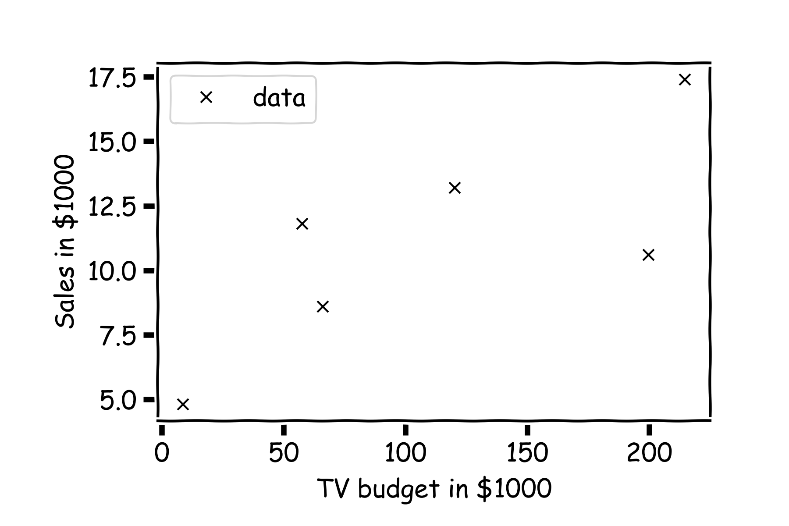
Estimate of the regression coefficients
For a given data set

Slide 32
Estimate of the regression coefficients (cont)
Is this line good?

Slide 33
Estimate of the regression coefficients (cont)
Maybe this one?

Slide 34
Estimate of the regression coefficients (cont)
Or this one?

Slide 35
Estimate of the regression coefficients (cont)
Question: Which line is the best?
First calculate the residuals

Slide 36
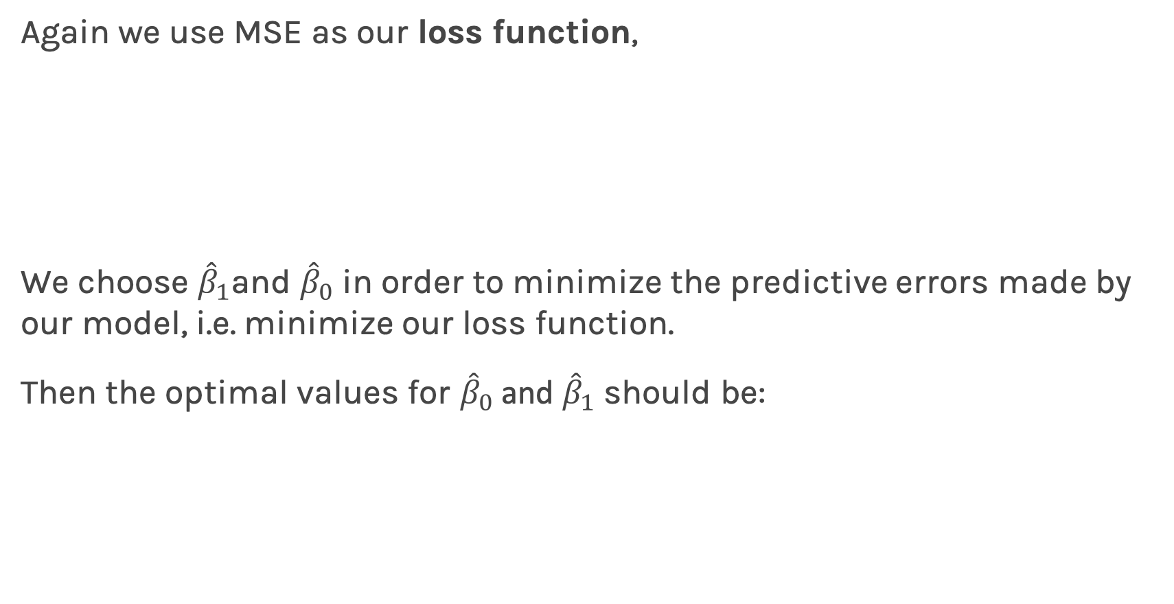
Estimate of the regression coefficients (cont)
Again we use MSE as our loss function,
We choose ${\hat{β}}_{1}$and ${\hat{β}}_{0}$ in order to minimize the predictive errors made by our model, i.e. minimize our loss function.
Then the optimal values for ${\hat{β}}_{0}$ and ${\hat{β}}_{1}$ should be:

Slide 37
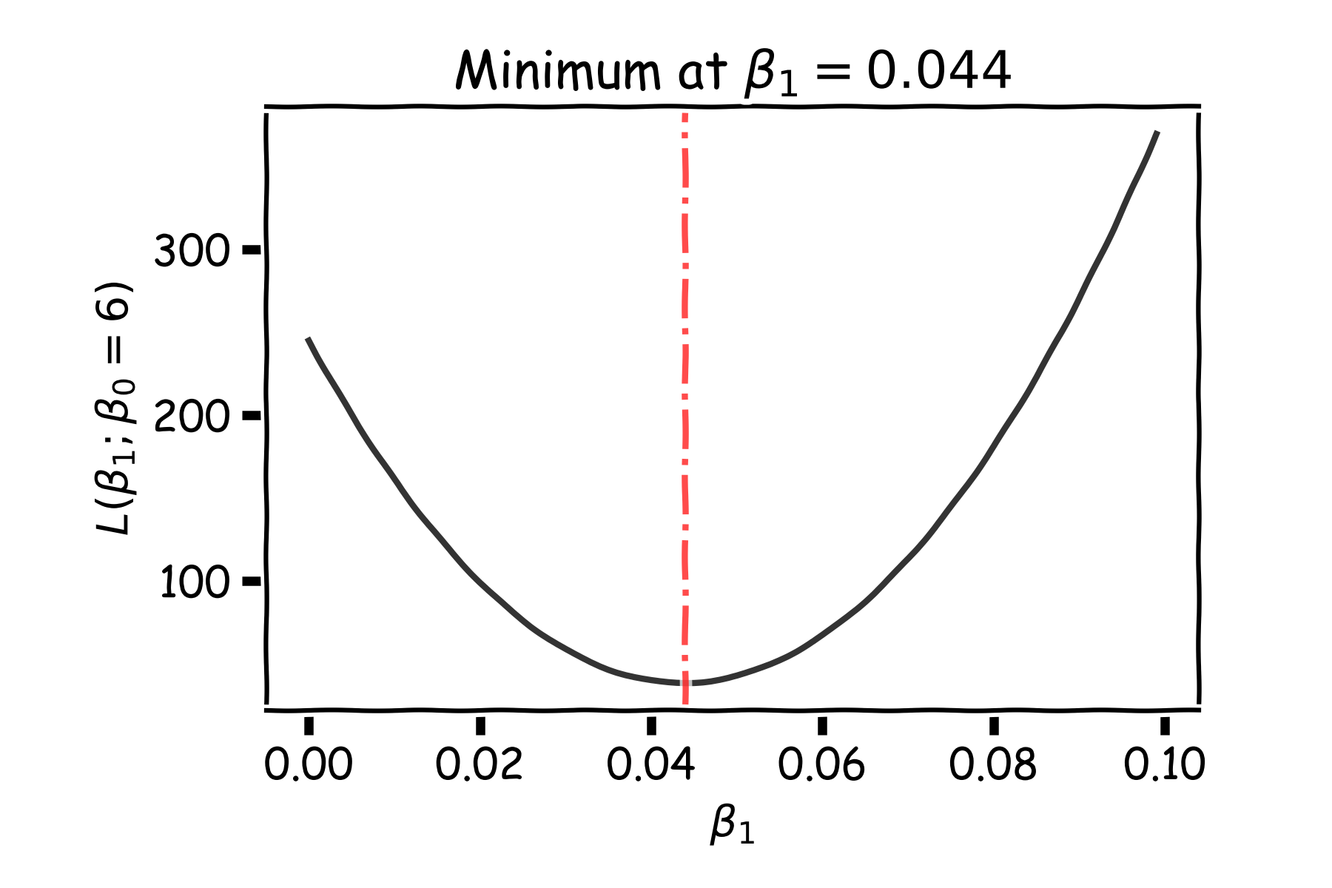
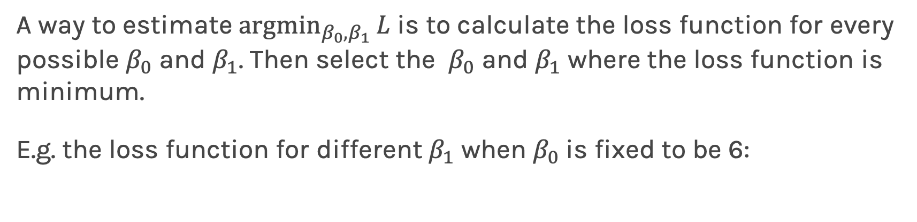
Estimate of the regression coefficients: brute force
A way to estimate ${argmin}_{β_{0},β_{1}}{L}$ is to calculate the loss function for every possible $β_{0}$ and $β_{1}$. Then select the $β_{0}$ and $β_{1}$ where the loss function is minimum.
E.g. the loss function for different $β_{1}$ when $β_{0}$is fixed to be 6:
Notes:
Shall I add a contour plot?

Slide 38
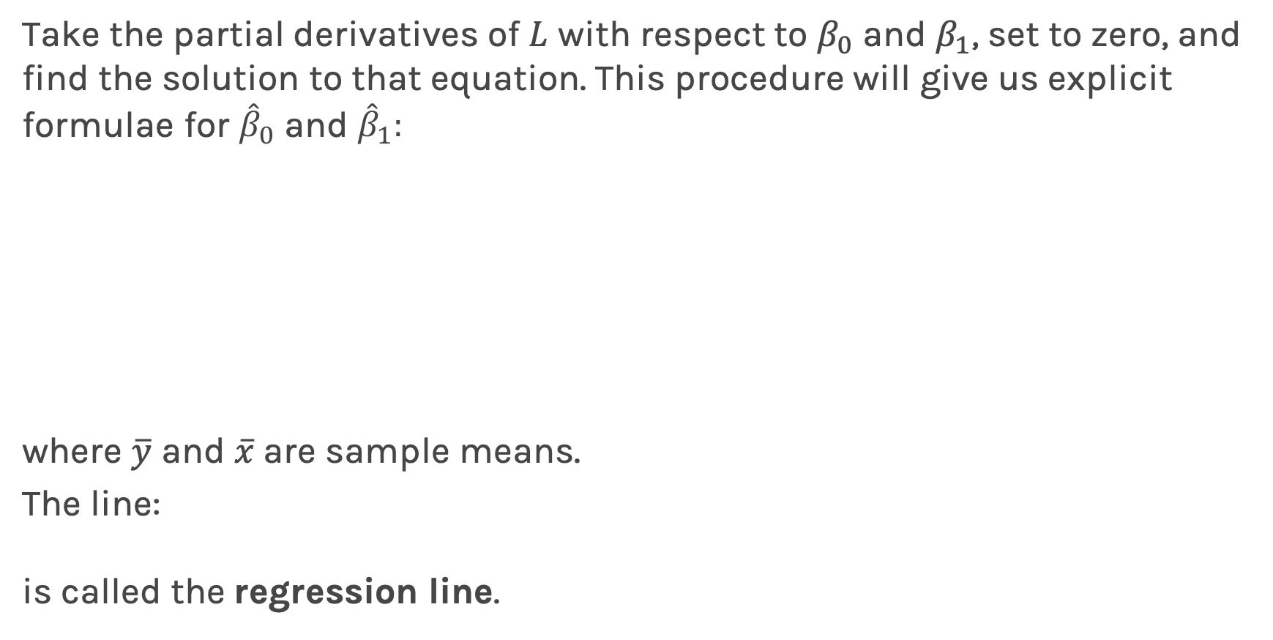
Estimate of the regression coefficients: exact method
Take the partial derivatives of $L$ with respect to $β_{0}$ and $β_{1}$, set to zero, and find the solution to that equation. This procedure will give us explicit formulae for ${\hat{β}}_{0}$ and ${\hat{β}}_{1}:$
where $\overline{y}$ and $\overline{x}$are sample means.
The line:
is called the regression line.

Slide 39
Notes:
Fix this

Slide 40
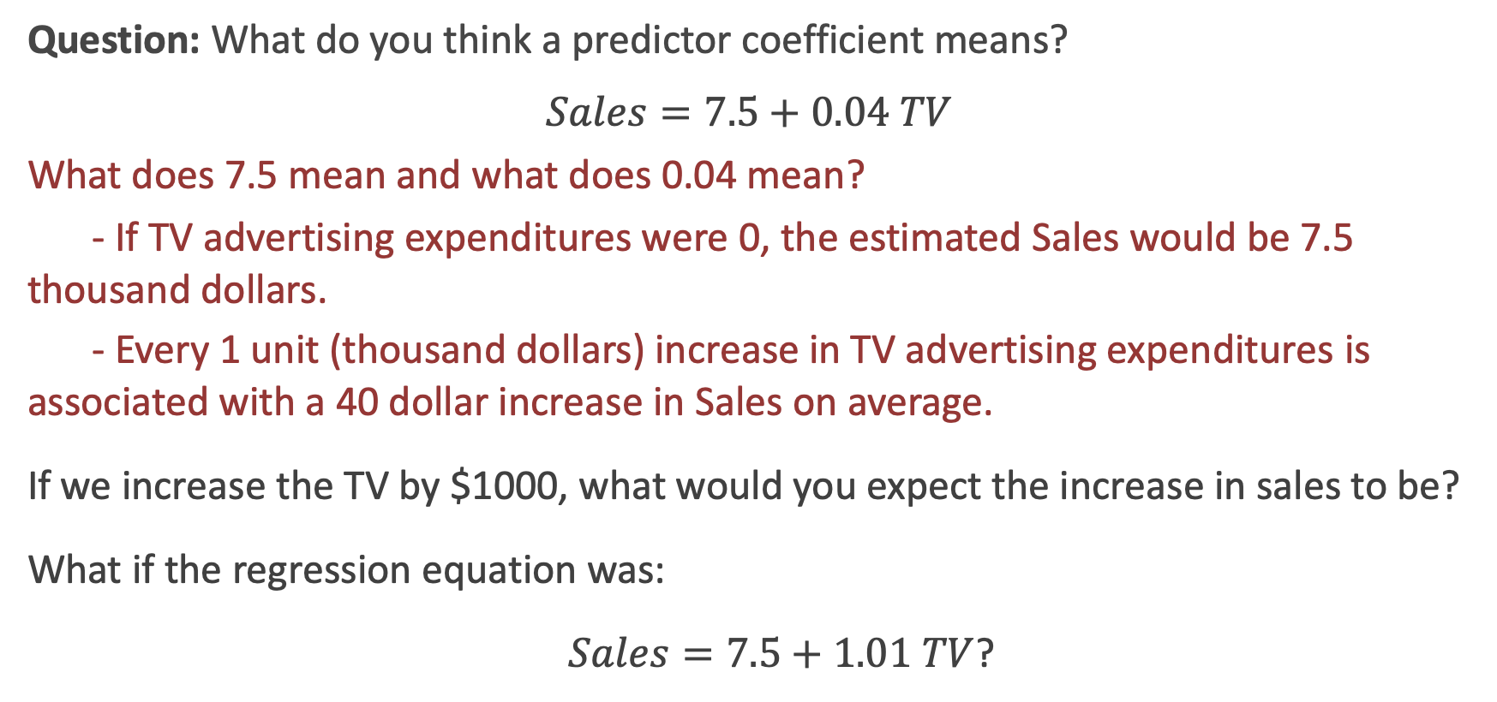
Interpretation of Coefficients
Question: What do you think a predictor coefficient means?
$$Sales=7.5+0.04 TV$$
What does 7.5 mean and what does 0.04 mean?
- If TV advertising expenditures were 0, the estimated Sales would be 7.5 thousand dollars.
- Every 1 unit (thousand dollars) increase in TV advertising expenditures is associated with a 40 dollar increase in Sales on average.
If we increase the TV by $1000, what would you expect the increase in sales to be?
What if the regression equation was:
$Sales=7.5+1.01 TV$?
Notes:
Axes labels! (DLS)

Slide 41
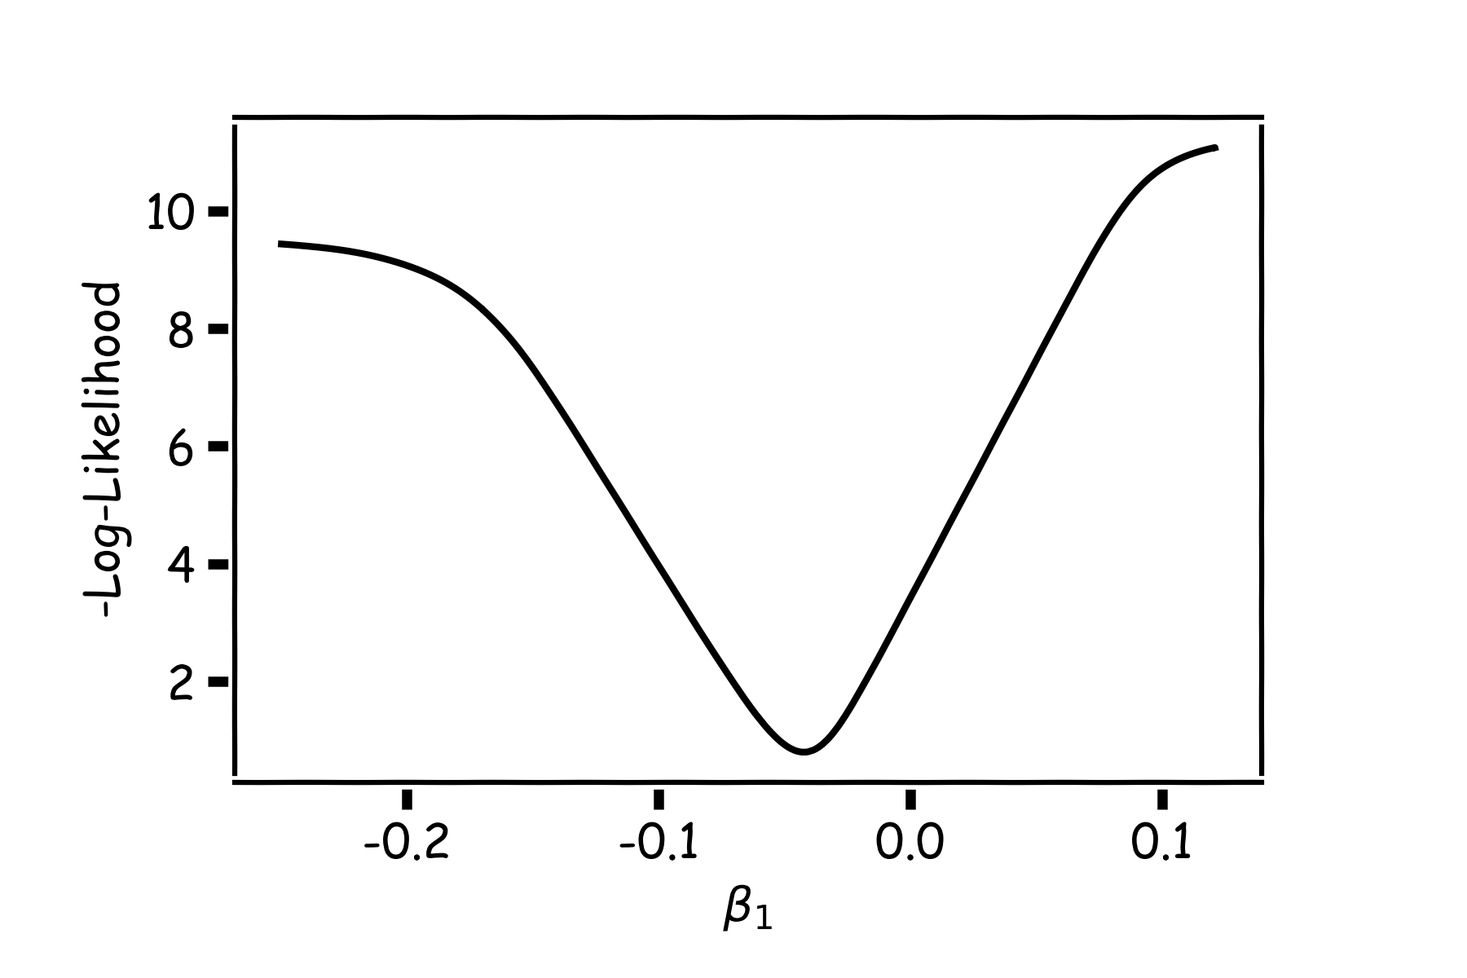
Estimate of the regression coefficients: gradient descent (a sidebar)
A more flexible method is
Start from a random point
Determine which direction to go to reduce the loss (left or right)
Compute the slope of the function at this point and step to the right if slope is negative or step to the left if slope is positive
Goto to #1

Slide 42
Estimate of the regression coefficients: gradient descent
Question: What is the mathematical function that describes the slope?
Derivative
Question: What do you think it is a good approach for telling the model how to change (what is the step size) to become better?
If the step is proportional to the slope then you avoid overshooting the minimum
Question: How do we generalize this to more than one predictor?
Take the derivative with respect to each coefficient and do the same sequentially
Notes:
S

Slide 43
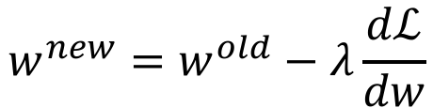
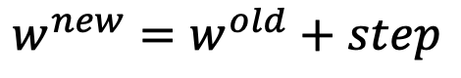
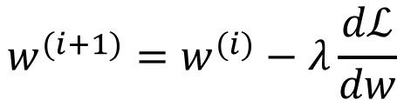
Estimate of the regression coefficients: gradient descent
We know that we want to go in the opposite direction of the derivative and we know we want to be making a step proportionally to the derivative.
Making a step means:
Notation: $w=β_{0}, β_{1}$
Learning Rate
$${w^{new}=w}^{old}+step$$
Opposite direction of the derivative and proportional to the derivative means:
$${w^{new}=w}^{old}−λ\frac{dℒ}{dw}$$
Change to more conventional notation:
$${w^{(i+1)}=w}^{(i)}−λ\frac{dℒ}{dw}$$

Slide 44
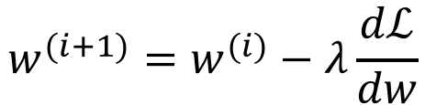
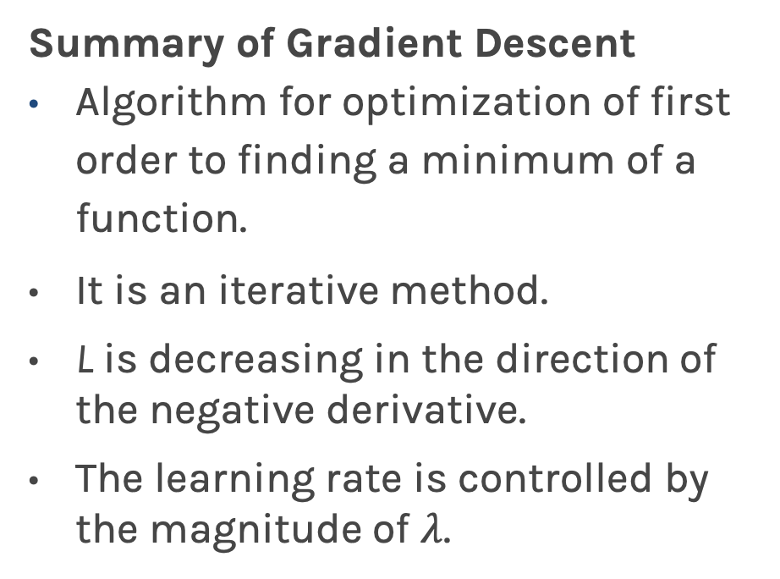
Estimate of the regression coefficients: gradient descent
Summary of Gradient Descent
Algorithm for optimization of first order to finding a minimum of a function.
It is an iterative method.
L is decreasing in the direction of the negative derivative.
The learning rate is controlled by the magnitude of $λ$.
$${w^{(i+1)}=w}^{(i)}−λ\frac{dℒ}{dw}$$
L
-
+
w

Slide 45
Gradient Descent: considerations
Gradient Descent Considerations (more in coming lectures)
We still need to derive or compute the derivatives.
We need to know what is the learning rate or how to set it.
We need to avoid local minima.
Finally, the full loss function includes summing up all individual ‘errors’. This can be hundreds of thousands of examples.
L
-
+
w

Slide 46
Gradient Descent: considerations
In linear regression, there is just one single minimum because the loss function is convex.
In linear regression the best coefficient estimates have a closed form solution, so no need for gradient descent.
If we were to change our loss function (say to minimize mean absolute error instead of mean square error), then gradient descent would be a very useful approach.
We will talk about optimization again in future lectures (in the context of Neural Networks, for example).

Slide 47
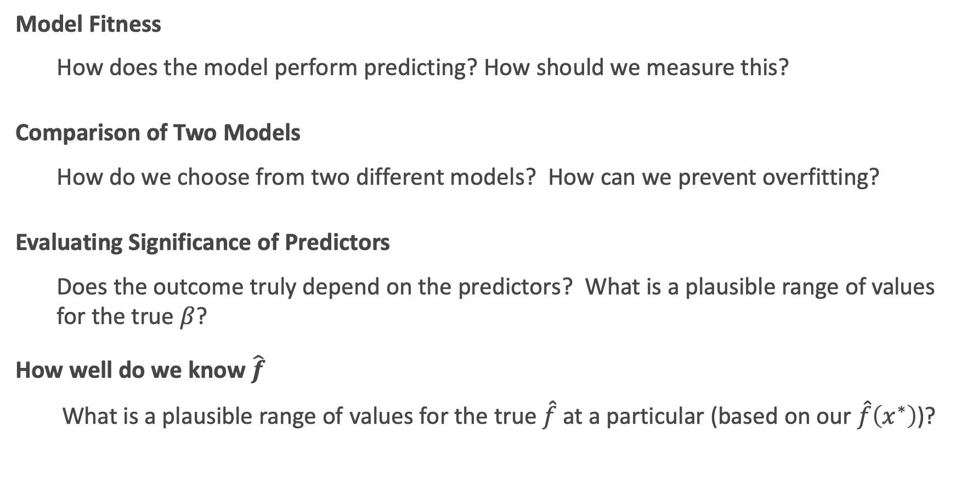
Things we will Consider
Model Fitness
How does the model perform predicting? How should we measure this?
Comparison of Two Models
How do we choose from two different models? How can we prevent overfitting?
Evaluating Significance of Predictors
Does the outcome truly depend on the predictors? What is a plausible range of values for the true $β$?
How well do we know $\hat{f}$
What is a plausible range of values for the true $\hat{f}$at a particular (based on our $\hat{f}\left(x^{∗}\right)$)?

Slide 48
Lecture Outline
Statistical Modeling
k-Nearest Neighbors (k-NN)
Simple Linear Regression
Model Fitness
How does the model perform at predicting?
Comparison of Two Models
How do we choose from two different models?
Probabilistic Basis of Regression
Hypothesis Testing and Confidence Intervals
Bootstrap Resampling

Slide 49
Error Evaluation
How can a model be evaluated for accuracy? What should we measure?
Some measurement or summary of the residuals (errors) from the model is a good choice…

Slide 50
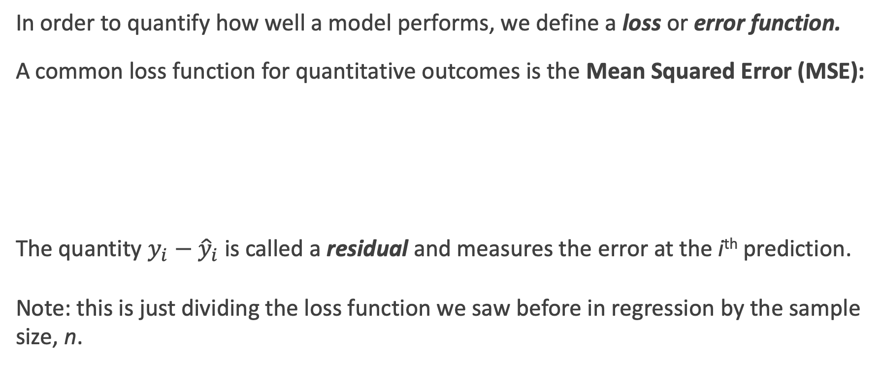
Error Evaluation: MSE
In order to quantify how well a model performs, we define a loss or error function.
A common loss function for quantitative outcomes is the Mean Squared Error (MSE):
The quantity $y_{i}−{\hat{y}}_{i}$ is called a residual and measures the error at the i^{th} prediction.
Note: this is just dividing the loss function we saw before in regression by the sample size, n.
Notes:
Change indeces and show k-nearest

Slide 51
Error Evaluation: RMSE
Caution: The MSE is by no means the only valid (or the best) loss function!
Question: What would be an intuitive loss function for predicting categorical outcomes?
Note: The square Root of the Mean of the Squared Errors (RMSE) is also commonly used.
Notes:
Change indeces and show k-nearest
Do you want to mention that RMSE isn’t always great b/c it’s not smooth? This would give them an idea on the things to consider when choosing loss functions. (DLS)

Slide 52
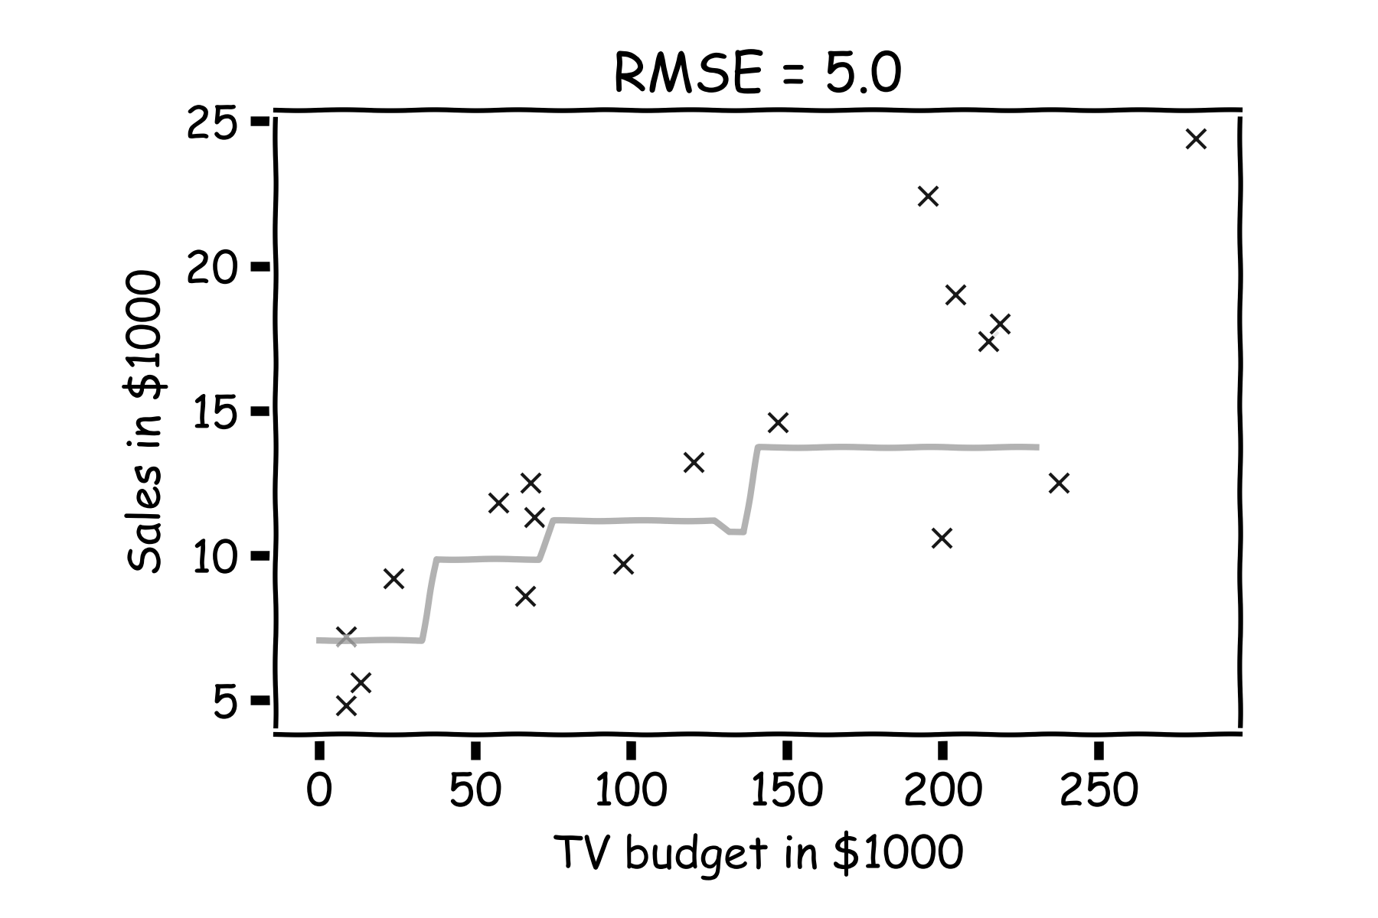
Model fitness
For a subset of the data, calculate the RMSE for k=3. Is RMSE=5.0 good enough?

Slide 53
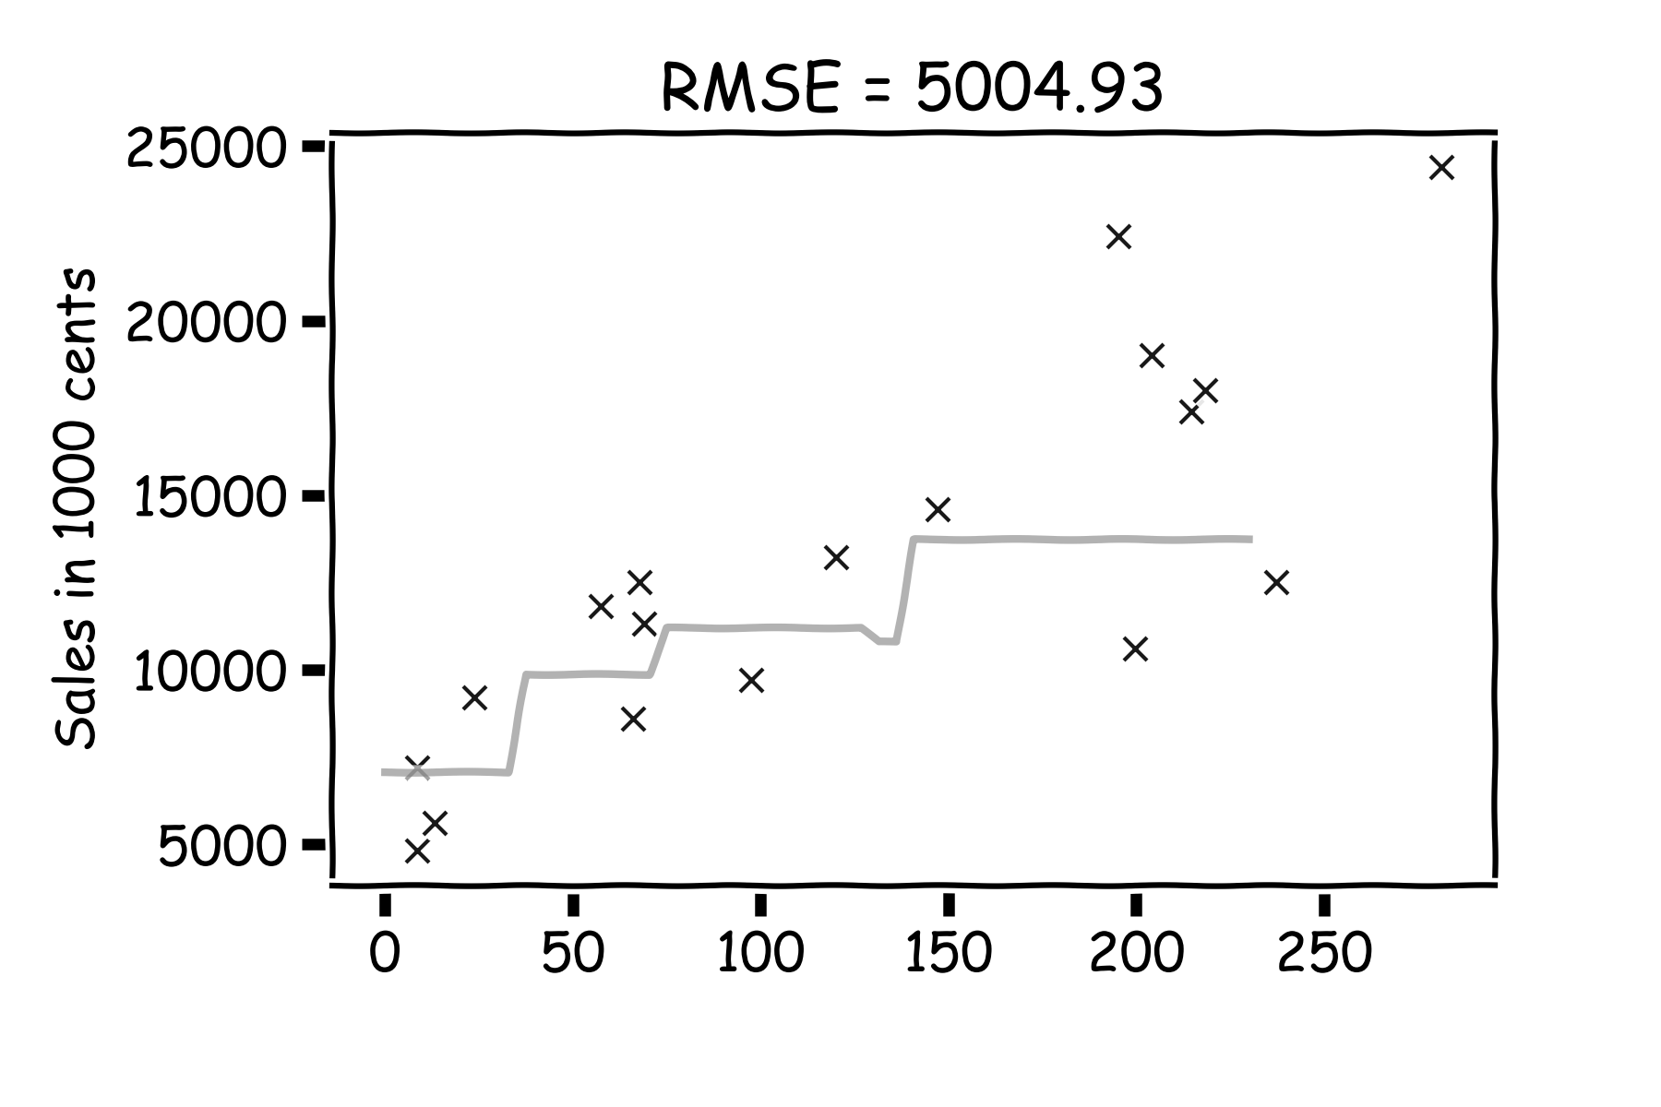
Model fitness
What if we measure the Sales in cents instead of dollars?
RMSE is now 5004.93.
Is the model now worse?

Slide 54
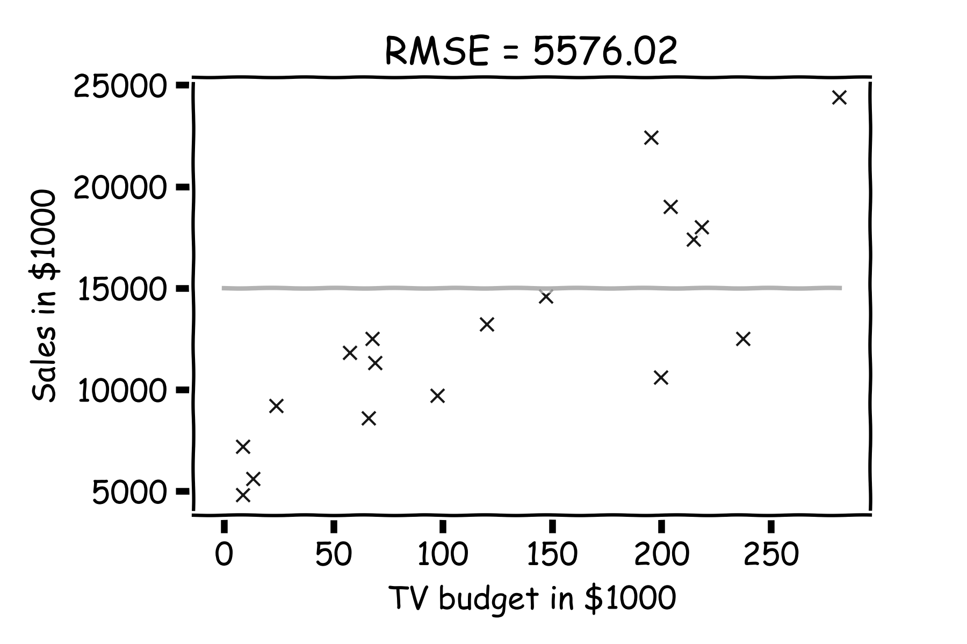
Model fitness
It is better if we compare it to something.
We will use the simplest model:
Notes:
Change this to a nicer plot
The subscript on the summation should be i=1 for clarity. I can’t seem to change this either… (DLS)

Slide 55
Error Evaluation: R²
Note: MSE and RMSE are dependent on the units of the response variable: which is both a good and a bad thing.
R² is an alternative metric: it gets rid of units and measures the percentage of variability in the response that is associated with the predictor(s) based on the model. This is in reference to the baseline of simply using the sample mean to do the predictions (aka, not using the predictors).

Slide 56
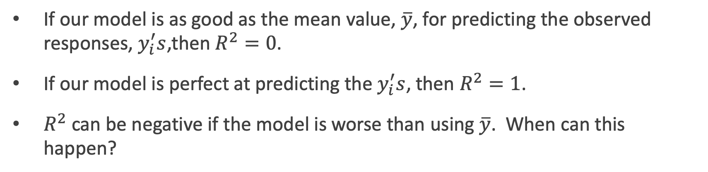
R²: some details
If our model is as good as the mean value, $\overline{y}$, for predicting the observed responses, $y_{i}^{′}s$,then $R^{2}=0$.
If our model is perfect at predicting the $y_{i}^{′}s$, then $R^{2}=1$.
$R^{2}$ can be negative if the model is worse than using $\overline{y}$. When can this happen?

Slide 57
Lecture Outline
Statistical Modeling
k-Nearest Neighbors (k-NN)
Simple Linear Regression
Model Fitness
How does the model perform at predicting?
Comparison of Two Models
How do we choose from two different models?
Probabilistic Basis of Regression
Hypothesis Testing and Confidence Intervals
Bootstrap Resampling

Slide 58
An introduction to overfitting
The metrics of model fitness/accuracy we’ve seen (SSE, MSE, RMSE, and R²) are all prone to the same issue: overfitting.
Overfitting can occur since a more complex model (like k = 1 in k-NN) will always(?) lead to more accurate results when evaluated on the same set of data that the model was fit (estimated) to.
This issue of overfitting can be cured (improved at least) by using a different set of data then what was used when fitting the model.
This is the basis of creating train-test splits: use the train set to fit/estimate the model, and use the test set to evaluate the model’s accuracy.

Slide 59
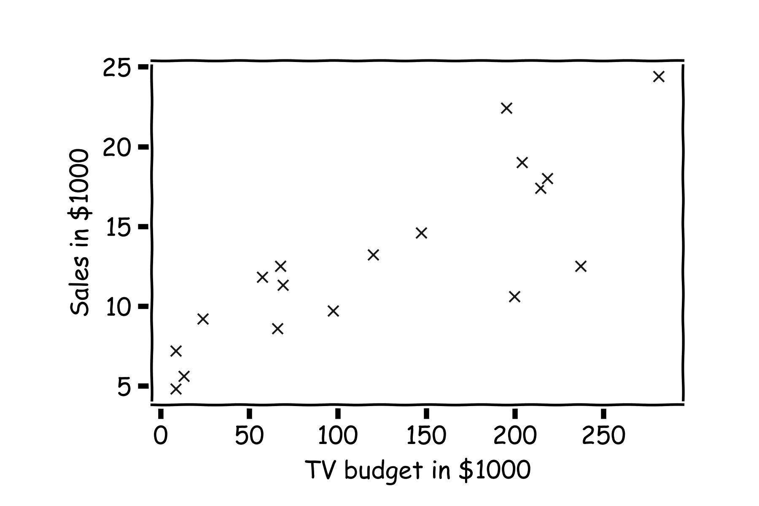
Error Evaluation
Start with some data.
Notes:
Change indeces and show k-nearest

Slide 60
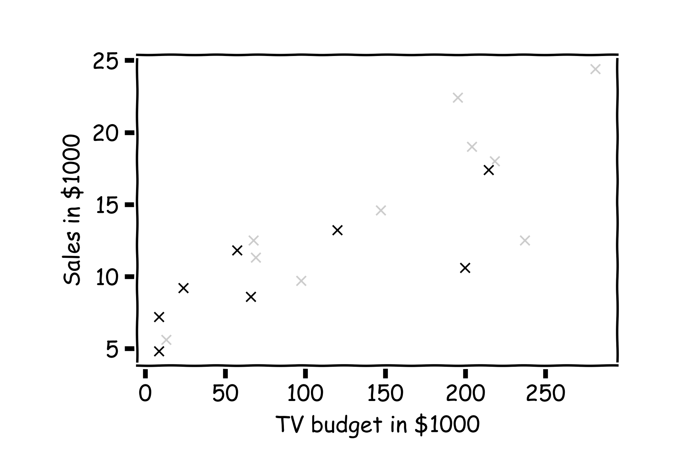
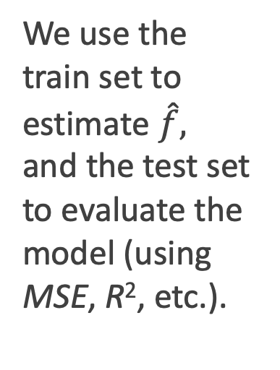
Error Evaluation
Hide some of the data from the model. This is called train-test split.
We use the train set to estimate $\hat{f},$ and the test set to evaluate the model (using MSE, R², etc.).

Slide 61
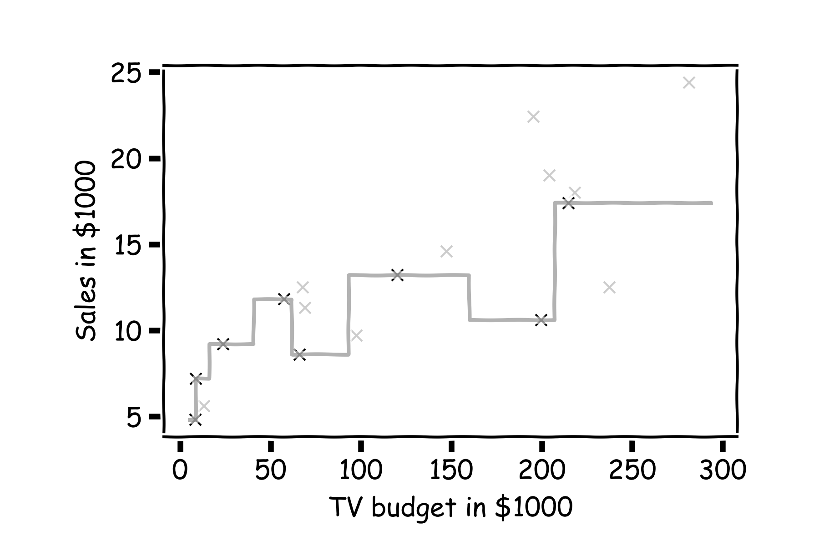

Error Evaluation
Estimate $\hat{y}$ for k=1 .
Notes:
Change indeces and show k-nearest

Slide 62

Error Evaluation
Now, we look at the data we have not used, the test data (red crosses).
Notes:
Change indeces and show k-nearest

Slide 63


Error Evaluation
Calculate the ${\text{residuals} (y}_{i}−{\hat{y}}_{i}).$
Notes:
Change indeces and show k-nearest

Slide 64

Error Evaluation
Do the same for k=3.
Notes:
Change indeces and show k-nearest

Slide 65

Model Comparison
Do the same for all k’s and compare the RMSEs (or MSEs or R²). k = 3 or 4 seem to be the best model. Which should we choose?

Slide 66

What!?!?

Slide 67
Lecture Outline
Statistical Modeling
k-Nearest Neighbors (k-NN)
Simple Linear Regression
Model Fitness
How does the model perform at predicting?
Comparison of Two Models
How do we choose from two different models?
Probabilistic Basis of Regression
Hypothesis Testing and Confidence Intervals
Bootstrap Resampling

Slide 68


Uncertainty of our coefficient estimates, ${\hat{β}}_{0}$ and ${\hat{β}}_{1}$
We interpret the $ε$term in our observation
to be noise introduced by random variations in natural systems or imprecisions of our scientific instruments.
If we knew the exact form of $f\left(x\right),$for example, $f\left(x\right)=β_{0}+β_{1}x$, and there was no $ε ,$ then estimating the ${\hat{β}}^{′}s$ would have been exact (so is 1.01 worth it?).
Notes:
Axes labels! (DLS)

Slide 69

Uncertainty of our coefficient estimates, ${\hat{β}}_{0}$ and ${\hat{β}}_{1}$ (cont.)
However, three things happen, which result in mistrust of the values of ${\hat{β}}^{′}s$:
$ε$ is always there
we do not know the exact form of $f\left(x\right)$
limited sample size
We will first address $ε$
We call $ε$the measurement error or irreducible error. Since even predictions made with the actual function $f$ will not match observed values of $y$.
Because of $ε,$ every time we measure the response $Y$ for a fix value of $X,$we will obtain a different observation, and hence a different estimate of ${\hat{β}}^{′}s.$

Slide 70

The Linear Regression Model
Recall that the linear regression model can be written as (for each individual observation):
$$y_{i}=β_{0}+β_{1}x_{i}+ε_{i}$$
To simplify the mathematics and uncertainty to perform inferences, a probabilistic model is often placed on the irreducible error (true residuals) term, $ε_{i}$:
$$ε_{i}∼N(0,σ^{2})$$
This can be listed as 4 assumptions based on the true residuals:
Residuals are normally distributed
Residuals have mean zero no matter the value of the $x_{i}$ (sometimes the linearity assumption)
Variance of the residuals is constant no matter the value of the $x_{i}$
Residuals are independent
Notes:
Axes labels! (DLS)

Slide 71

Consequences of the Probabilistic Regression Model
$$y_{i}=β_{0}+β_{1}x_{i}+ε_{i}$$
$$ε_{i}∼N(0,σ^{2})$$
If this model is correct (or at least reasonable), then the sampling distribution (aka, the distribution of values we would expect for the estimated $β_{0}$ and $β_{1}$ whenever a sample of data is taken) have well-known distributions:
$${\hat{β}}_{0}∼N\left(β_{0},σ^{2}\left(\frac{1}{n}+\frac{{\overline{x}}^{2}}{∑{\left(x_{i}−\overline{x}\right)}^{2}}\right)\right)$$
$${\hat{β}}_{1}∼N\left(β_{1},\frac{σ^{2}}{∑{\left(x_{i}−\overline{x}\right)}^{2}}\right)$$
We will see that these formula will generalize when we get to multiple linear regression (multiple predictors), we just need to use linear algebra ☺
Notes:
Axes labels! (DLS)

Slide 72

Building the sampling distributions of ${\hat{β}}_{0}$ and ${\hat{β}}_{1}$
Start with a model

Slide 73

Building the sampling distributions of ${\hat{β}}_{0}$ and ${\hat{β}}_{1}$ (cont.)
For a some values of $X,$ $Y=f(X)$

Slide 74

Building the sampling distributions of ${\hat{β}}_{0}$ and ${\hat{β}}_{1}$ (cont.)
But due to error, every time we measure the response Y for a fixed value of X we will obtain a different observation.

Slide 75

Building the sampling distributions of ${\hat{β}}_{0}$ and ${\hat{β}}_{1}$ (cont.)
One set of observations, “one realization” we obtain one set of Ys (red crosses).

Slide 76

Building the sampling distributions of ${\hat{β}}_{0}$ and ${\hat{β}}_{1}$ (cont.)
Another set of observations, “another realization” we obtain another set of Ys (green crosses).

Slide 77

Building the sampling distributions of ${\hat{β}}_{0}$ and ${\hat{β}}_{1}$ (cont.)
Another set of observations, “another realization” we obtain another set of Ys (black crosses).

Slide 78


Building the sampling distributions of ${\hat{β}}_{0}$ and ${\hat{β}}_{1}$ (cont.)
For each one of those “realizations”, we could fit a model and estimate ${\hat{β}}_{0}$ and ${\hat{β}}_{1}.$

Slide 79


Building the sampling distributions of ${\hat{β}}_{0}$ and ${\hat{β}}_{1}$ (cont.)
For each one of those “realizations”, we could fit a model and estimate, ${\hat{β}}_{0}$ and ${\hat{β}}_{1}.$

Slide 80

Building the sampling distributions of ${\hat{β}}_{0}$ and ${\hat{β}}_{1}$ (cont.)
For each one of those “realizations”, we could fit a model and estimate, ${\hat{β}}_{0}$ and ${\hat{β}}_{1}.$

Slide 81

Building the sampling distributions of ${\hat{β}}_{0}$ and ${\hat{β}}_{1}$ (cont.)
So if we just have one set of measurements of $\{X,Y\},$our estimates of ${\hat{β}}_{0}$ and ${\hat{β}}_{1}$ are just for this particular realization.
Notes:
Gabriel García Márquez, whose novel One Hundred Years of Solitude … magic realism.

Slide 82
Lecture Outline
Statistical Modeling
k-Nearest Neighbors (k-NN)
Simple Linear Regression
Model Fitness
How does the model perform at predicting?
Comparison of Two Models
How do we choose from two different models?
Probabilistic Basis of Regression
Hypothesis Testing and Confidence Intervals
Bootstrap Resampling

Slide 83

Confidence intervals for the predictors estimates (cont)
So if we just have one set of measurements of $\{X,Y\},$our estimates of ${\hat{β}}_{0}$ and ${\hat{β}}_{1}$ are just for this particular realization.
Question: If this is just one realization of the reality how do we know the truth? How do we deal with this conundrum?
Imagine (magic realism) we have parallel universes and we repeat this experiment on each of the other universes.
Universe A
Universe B
Universe C
Notes:
Gabriel García Márquez, whose novel One Hundred Years of Solitude … magic realism.

Slide 84

Confidence intervals for the predictors estimates (cont)
$$.$$
In our magical realisms, we can now sample multiple times

Slide 85

Confidence intervals for the predictors estimates (cont)
Another sample

Slide 86

Confidence intervals for the predictors estimates (cont)
Another sample

Slide 87

Confidence intervals for the predictors estimates (cont)
And another sample

Slide 88

Confidence intervals for the predictors estimates (cont)
Repeat this for 100 times (or better yet: 1,000 times)

Slide 89


Confidence intervals for the predictors estimates (cont)
We can now estimate the mean and standard deviation of all the estimates ${\hat{β}}_{1}$.
The variance of ${\hat{β}}_{0}$ and ${\hat{β}}_{1}$ are also called their standard errors, $SE\left({\hat{β}}_{0}\right),SE\left({\hat{β}}_{1}\right).$
2

Slide 90


Confidence intervals for the predictors estimates (cont)
Finally we can calculate the confidence intervals, which are the ranges of values such that the true value of $β_{1}$is contained in this interval with n percent probability.
95%
68%

Slide 91



And also we can answer the question, ’how significant are the predictors?’ Here we show the same analysis for all three predictors.
Question: Which ones are important?
Before we answer this question, we need to answer another question.

Slide 92
And also we can answer the question, ’how significant are the predictors?’ Here we show the same analysis for all three predictors.
Question: Which ones are important?
Before we answer this question, we need to answer another question.

Slide 93
And also we can answer the question, ’how significant are the predictors?’ Here we show the same analysis for all three predictors.
Question: Which ones are important?
Now we know how to generate these distributions we are ready to answer ’how significant are the predictors?’

Slide 94
Hypothesis Testing
Hypothesis testing is a formal process through which we evaluate the validity of a statistical hypothesis by considering evidence for or against the hypothesis gathered by random sampling of the data.

Slide 95






TV | sales
68.4 | 22.1
202.5 | 10.4
248.8 | 9.3
191.1 | 18.5
23.8 | 12.9
296.4 | 7.2
26.8 | 11.8
164.5 | 13.2
209.6 | 4.8
147.3 | 10.6
139.2 | 8.6
109.8 | 17.4
43.0 | 9.2
73.4 | 9.7
262.7 | 19.0
28.6 | 22.4
135.2 | 12.5
240.1 | 24.4
Random sampling of the data
Shuffle the values of the predictor variable
TV | sales
50.0 | 22.1
184.9 | 10.4
11.7 | 9.3
219.8 | 18.5
13.1 | 12.9
248.8 | 7.2
76.4 | 11.8
197.6 | 13.2
195.4 | 4.8
75.5 | 10.6
238.2 | 8.6
222.4 | 17.4
171.3 | 9.2
184.9 | 9.7
193.2 | 19.0
131.7 | 22.4
116.0 | 12.5
166.8 | 24.4
TV | sales
88.3 | 22.1
102.7 | 10.4
204.1 | 9.3
39.5 | 18.5
68.4 | 12.9
59.6 | 7.2
70.6 | 11.8
265.2 | 13.2
292.9 | 4.8
76.4 | 10.6
80.2 | 8.6
182.6 | 17.4
112.9 | 9.2
199.1 | 9.7
147.3 | 19.0
89.7 | 22.4
225.8 | 12.5
193.2 | 24.4
TV | sales
215.4 | 22.1
89.7 | 10.4
68.4 | 9.3
75.3 | 18.5
142.9 | 12.9
220.3 | 7.2
255.4 | 11.8
139.5 | 13.2
237.4 | 4.8
16.9 | 10.6
13.1 | 8.6
218.5 | 17.4
147.3 | 9.2
25.6 | 9.7
216.4 | 19.0
238.2 | 22.4
213.4 | 12.5
109.8 | 24.4
TV | sales
216.4 | 22.1
276.7 | 10.4
23.8 | 9.3
13.2 | 18.5
26.8 | 12.9
170.2 | 7.2
0.7 | 11.8
87.2 | 13.2
120.5 | 4.8
293.6 | 10.6
78.2 | 8.6
43.0 | 17.4
139.2 | 9.2
276.9 | 9.7
239.3 | 19.0
191.1 | 22.4
25.1 | 12.5
25.6 | 24.4
TV | sales
230.1 | 22.1
44.5 | 10.4
17.2 | 9.3
151.5 | 18.5
180.8 | 12.9
8.7 | 7.2
57.5 | 11.8
120.2 | 13.2
8.6 | 4.8
199.8 | 10.6
66.1 | 8.6
214.7 | 17.4
23.8 | 9.2
97.5 | 9.7
204.1 | 19.0
195.4 | 22.4
67.8 | 12.5
281.4 | 24.4

Slide 96



Slide 97




Importance of predictors
In practice, we do not need the distribution for Null.
Define a test statistic, which we we call t-test statistic
Which measures the distance from zero in units of
standard deviation.
We evaluate how often a particular value of t can occur by accident. We expect that t will have a t-distribution with n-2 degrees of freedom.
To compute the probability of observing any value equal to $|t|$ or larger, assuming ${\hat{β}}_{1}=0$ is easy. We call this probability the p-value.
a small p-value (<0.05) indicates that it is unlikely to observe such a substantial association between the predictor and the response due to chance.
$$μ_{{\hat{β}}_{1}}−0$$
2
$$σ_{{\hat{β}}_{1}}$$
$$t=\frac{μ_{{\hat{β}}_{1}}}{{\hat{σ}}_{{\hat{β}}_{1}}}$$
Notes:
FIX THIS

Slide 98

Hypothesis Testing
Hypothesis testing is a formal process through which we evaluate the validity of a statistical hypothesis by considering evidence for or against the hypothesis gathered by random sampling of the data.
State the hypotheses, typically a null hypothesis, $H_{0}$ and an alternative hypothesis, $H_{1}$, that is the negation of the former.
Choose a type of analysis, i.e. how to use sample data to evaluate the null hypothesis. Typically this involves choosing a single test statistic.
Sample data and compute the test statistic.
Use the value of the test statistic to either reject or not reject the null hypothesis.

Slide 99
Lecture Outline
Statistical Modeling
k-Nearest Neighbors (k-NN)
Simple Linear Regression
Model Fitness
How does the model perform at predicting?
Comparison of Two Models
How do we choose from two different models?
Probabilistic Basis of Regression
Hypothesis Testing and Confidence Intervals
Bootstrap Resampling

Slide 100
Bootstrap
In the lack of active imagination, parallel universes and the likes, or trusting the probabilistic models, we need an alternative way of producing fake data set that resemble the parallel universes.
.
Bootstrapping is the practice of sampling from the observed data (X,Y) in estimating statistical properties.

Slide 101
Bootstrap
Imagine we have 5 billiard balls in a bucket.

Slide 102
Bootstrap
We first pick randomly a ball and replicate it. This is called sampling with replacement.
We move the replicated ball to another bucket.

Slide 103
Bootstrap

Slide 104
Bootstrap
We then randomly pick another ball and again we replicate it.
As before, we move the replicated ball to the other bucket.

Slide 105
Bootstrap

Slide 106
Bootstrap
We repeat this process.
Notes:
Fix this with true replacement

Slide 107
Bootstrap
Again

Slide 108
Bootstrap
And again

Slide 109
Bootstrap
Until the “other” bucket has the same number of balls as the original one.
This new bucket represents a new parallel universe

Slide 110
Bootstrap
We repeat the same process and acquire another sample.

Slide 111
Bootstrap
We repeat the same process and acquire another sample.
These new buckets represents the parallel universes

Slide 112

Bootstrapping for Estimating Sampling Error
Definition
Bootstrapping is the practice of estimating properties of an estimator by measuring those properties by, for example, resampling from the observed data.
For example, we can compute ${\hat{β}}_{0}$ and ${\hat{β}}_{1}$multiple times by randomly resampling from our data set (the same sample size to maintain the same amount of uncertainty in each resample). We then use the variance of our multiple estimates to approximate the true variance of ${\hat{β}}_{0}$ and ${\hat{β}}_{1}$.

Slide 113

Confidence intervals for the predictors estimates: Standard Errors
We can empirically estimate the standard errors, $SE\left({\hat{β}}_{0}\right),SE\left({\hat{β}}_{1}\right)$ of $β_{0}$ and $β_{1}$through bootstrapping.
If for each bootstrapped sample the estimated betas are: ${\hat{β}}_{0,i}$, ${\hat{β}}_{1,i}$, then
$$SE\left({\hat{β}}_{0}\right)=\sqrt{var(\hat{β_{0}})}$$
$$SE\left({\hat{β}}_{1}\right)=\sqrt{var(\hat{β_{1}})}$$
Notes:
If data set is small this approximation does not work

Slide 114

Confidence intervals for the predictors estimates: Standard Errors
Alternatively:
If we know the variance $σ_{ε}^{2}$ of the noise $ε$, we can compute $SE\left({\hat{β}}_{0}\right),SE\left({\hat{β}}_{1}\right)$ analytically using the formulae below (no need to bootstrap):
*Note: these formulas do not rely on the normality assumption. But they do rely on independence, constant variance, and linearity.
Notes:
If data set is small this approximation does not work

Slide 115


Standard Errors
More data: $n↑$ and $\sum_{i}{({x_{i}−\overline{x})}^{2}}↑⟹SE↓$
Larger coverage: $var(x)$ or $\sum_{i}{({x_{i}−\overline{x})}^{2}}↑ ⟹$ $SE↓$
Better data: $σ^{2}↓ ⇒SE↓$
In practice, we do not know the theoretical value of $σ$ since we do not know the exact distribution of the noise $ε$.
Notes:
If data set is small this approximation does not work

Slide 116


Standard Errors
However, if we make the following assumptions,
the errors $ε_{i}=y_{i}−{\hat{y}}_{i}$and $ε_{j}=y_{j}−{\hat{y}}_{j}$ are uncorrelated, for $i≠j$ ,
each $ε_{i}$ has a mean 0 and variance $σ_{ε}^{2}$,
then, we can empirically estimate $σ^{2}$, from the data and our regression line:
Remember:
$$y_{i}=f\left(x_{i}\right)+ε_{i}⟹ε_{i}=y_{i}−f(x_{i})$$

Slide 117

Standard Errors
More data: $n↑$ and $\sum_{i}{({x_{i}−\overline{x})}^{2}}↑⟹SE↓$
Larger coverage: $var(x)$ or $\sum_{i}{({x_{i}−\overline{x})}^{2}}↑ ⟹$ $SE↓$
Better data: $σ^{2}↓ ⇒SE↓$
Better model: $(\hat{f}−y_{i}) ↓$ $⟹σ↓ ⟹SE↓$
Question: What happens to the $\hat{β_{0}}$, $\hat{β_{1}}$ under these scenarios?

Slide 118

Standard Errors
The following results are for the coefficients for TV advertising:
Method | $$SE\left({\hat{β}}_{1}\right)$$
Analytic Formula | 0.0061
Bootstrap | 0.0061
The coefficients for TV advertising but restricting the coverage of x are:
The coefficients for TV advertising but with added extra noise:
Method | $$SE\left({\hat{β}}_{1}\right)$$
Analytic Formula | 0.0068
Bootstrap | 0.0068
Does this make sense?
Method | $$SE\left({\hat{β}}_{1}\right)$$
Analytic Formula | 0.0028
Bootstrap | 0.0023

Slide 119


Hypothesis testing
1. State Hypothesis:
Null hypothesis:
$H_{0}$: There is no relation between X and Y
The alternative:
$H_{a}$: There is some relation between X and Y
2: Choose test statistics
To test the null hypothesis, we need to determine whether, our estimate for ${\hat{β}}_{1}$, is sufficiently far from zero that we can be confident that ${\hat{β}}_{1}$ is non-zero. We use the following test statistic:
$$t=\frac{μ_{{\hat{β}}_{1}}}{σ_{{\hat{β}}_{1}}}$$

Slide 120

Hypothesis testing
3. Sample:
Using quasi-bootstrap we can estimate ${\hat{β}}_{1}^{′}s$, and therefore $μ_{{\hat{β}}_{1}}$and $σ_{{\hat{β}}_{1}}.$
4. Reject or not reject the hypothesis:
If there is really no relationship between X and Y , then we expect that will have a t-distribution with n-2 degrees of freedom.
To compute the probability of observing any value equal to $|t|$ or larger, assuming ${\hat{β}}_{1}=0$ is easy. We call this probability the p-value.
a small p-value indicates that it is unlikely to observe such a substantial association between the predictor and the response due to chance

Slide 121
What’s next?
Multiple Regression (aka, multiple predictors)
Collinearity
Categorical predictors
Polynomial regression
Piecewise Linear Regression
Interaction terms
Variable (predictor) selection

